Slide 1
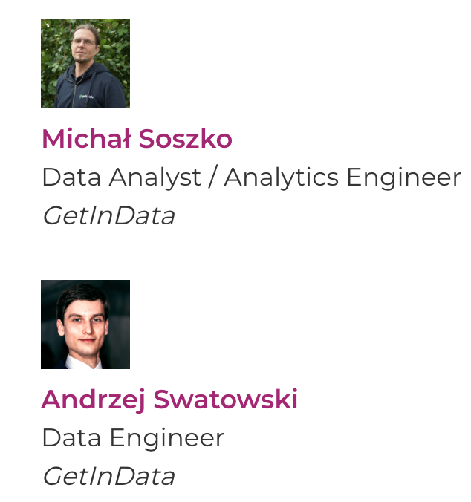
Build reliable data pipelines using Modern Data Stack in the cloud

Slide 2
Readiness
check
Checklist:
Chrome or Microsoft Edge
Invitation to join GitLab project
Please send your google email address to: andrzej.swatowski@getindata.com
Visit: https://gitlab.com/bdtw-mdp-workshop
Today’s exercises: https://github.com/getindata/gid-mdp-workshop

Slide 3
Today’s agenda
Session 1 - Introduction to Modern Data Stack
What is Modern Data Stack? Intro
Key components of MDS
Core concepts of dbt
Hands-on exercises
Session 2 - Simple end-do-end data pipeline
Transforming data using SQL with dbt
Data testing using dbt
Hands-on exercises
Session 3 - data pipeline scheduling, deployment, advanced dbt concepts
Productionalization of dbt models
Data Catalog
Advanced concepts of dbt
Connecting to BI Tool: Looker Studio
Hands-on exercises
Today’s schedule
09:00 - 10:30 - Session 1
11:00 - 13:00 - Session 2
13:45 - 15:45 - Session 3
16:00 - 17:00 - Session 4 (Q&A)
Lunch Break: 13:00 - 13:45

Slide 4
Key takeaways
After this workshop you should…
Know what Modern Data Stack is about
Have a hands-on experience with transforming data in dbt
Learn how to orchestrate your data pipelines using best engineering practices without IT dependencies
Know how to use modern data catalogs to search and explore the data
Be able to prevent data quality issues by data testing & monitoring

Slide 5
Agenda
Session 1 - Introduction to Modern Data Stack
What is Modern Data Stack? Intro
Key components of MDS
Core concepts of dbt
Hands-on exercises: creating your own workspace

Slide 6
What is modern data stack?
Saves time, effort, and money
Shift from once-off analytics to operational BI and AI
Business (not IT) focused operating model
Airbyte, dbt, Snowflake, Looker, etc.
Data governance as a first-class citizen
Modern Data Stack (MDS) is a set of tools hosted in the cloud that enables an organization for highly efficient data integration (...)
MDS creates clean, trustworthy, and always available data that can empower business users to make self-service discoveries, enabling a truly data-driven culture.
Source: neptune.ai
Cloud based, flexible & scalable, plug-and-play, no long term commitments

Slide 7


Data platform challenges
Outdated data docs
Costly licensing
No flexibility
Sounds familiar?
Too much engineering
Vendor lock-in
Chaotic project structures
Long time-to-value
Unreliable data

Slide 8

The Modern Data Platform manifest (needs)
Self-service!
Trusted & documented data!
Project templates!
Low-code transforms!
All-in-one workbench!
Adaptable!
Data access security!
Simple to set up & use!
We need to change the way we think about data platform…

Slide 9

Why is MDP possible? (enablers)
Cloud DWH
(e.g. BigQuery)
Low-code transformation tools (e.g. dbt)
Data integration frameworks
(e.g. Airbyte)
Architecture, data security & engineering best practices
Modern data catalogs
(e.g. Data Hub)
Self-serve BI tools (e.g. Looker)
The technology is already here!

Slide 10
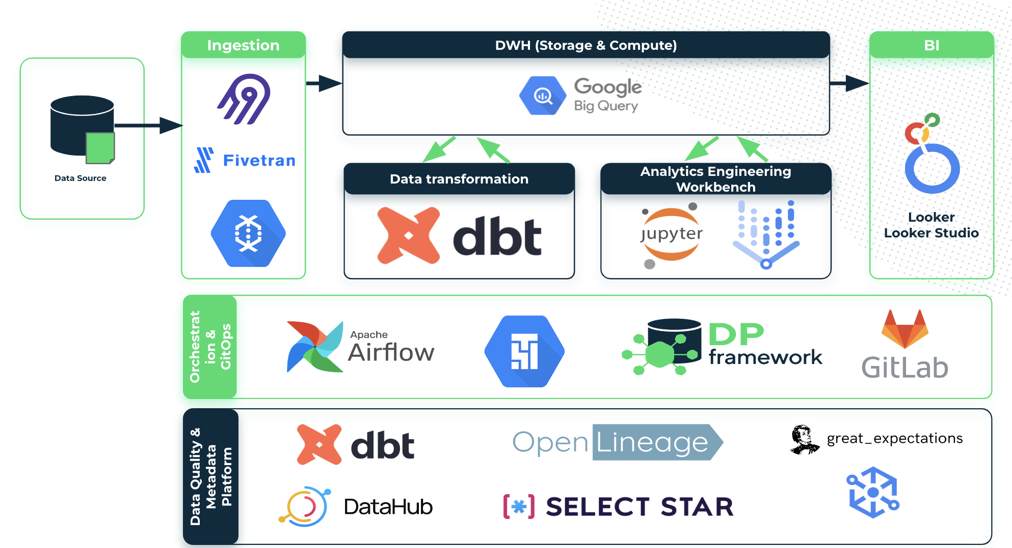
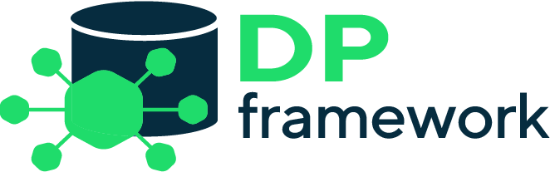
GetInData Modern Data Platform -
the framework and its components
Solution optimized for:
any cloud / on-premise
flexibility & extensibility
self-service
data mesh readiness
modularity
automation
observability & discovery
data-pipelines-cli
dbt-airflow-factory
Project Template Factory

Slide 11















GetInData Modern Data Platform -
the framework and its components
Ingestion
DWH (Storage & Compute)
BI
Data Source
Data transformation
Analytics Engineering Workbench
Looker
Looker Studio
Orchestration & GitOps
Data Quality, Observability & Metadata Management
Dataplex

Slide 12
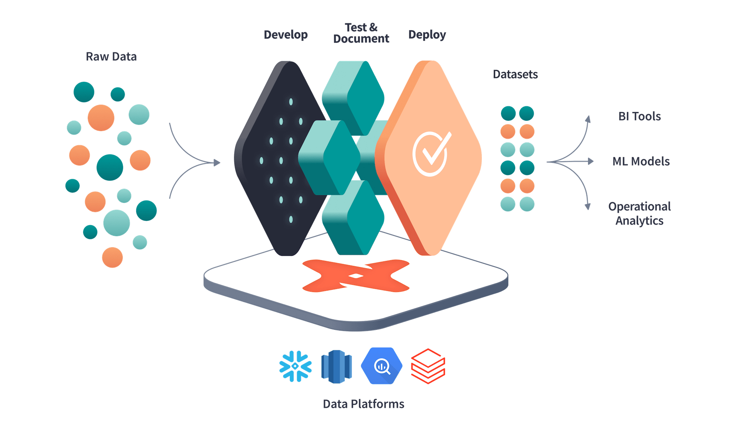
Core concepts of dbt
“dbt™ is a transformation workflow that lets teams quickly and collaboratively deploy analytics code following software engineering best practices like modularity, portability, CI/CD, and documentation. Now anyone who knows SQL can build production-grade data pipelines.”
getdbt.com
Source: getdbt.com

Slide 13
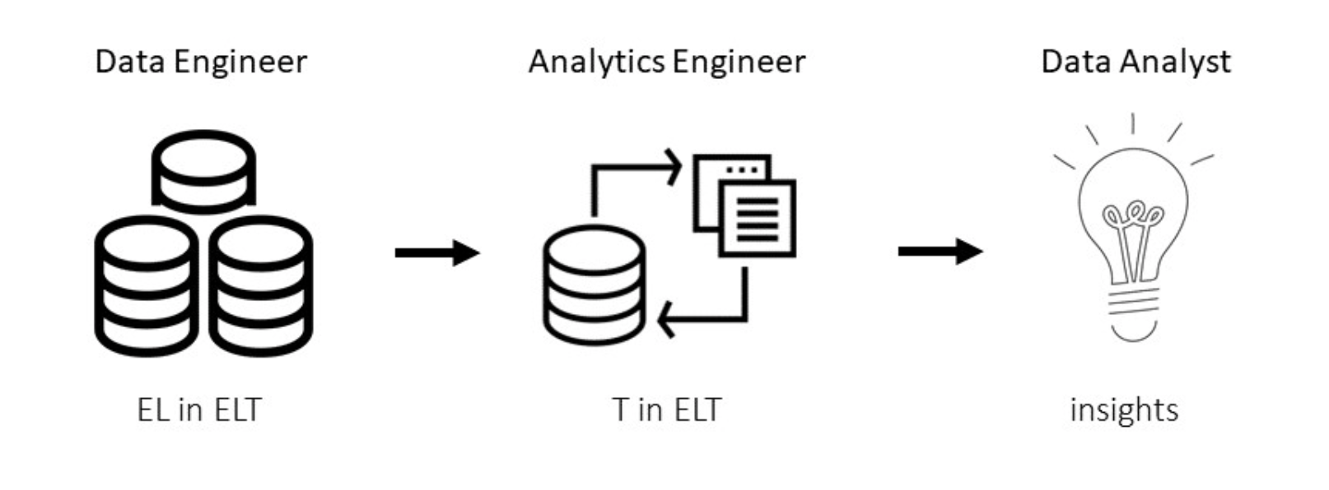
Core concepts of dbt
What problem does dbt solve?
Provides software engineering-grade way of writing data analysis code
Compiler & runner
Automated testing
documentation
project structuring
resolving dependencies
environments configuration
SQL
Python
(recently)

Slide 14
Core concepts of dbt
SQL
select *
from table_A
where column_B > 0
jinja
{{ function( ‘var1’, ‘var2’, …. ) }}
{{ config (‘....’) }}
CLI
C:\project\dbt run – select my_model.sql
C:\project\dbt compile

Slide 15
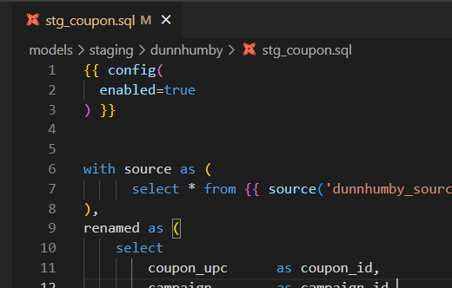
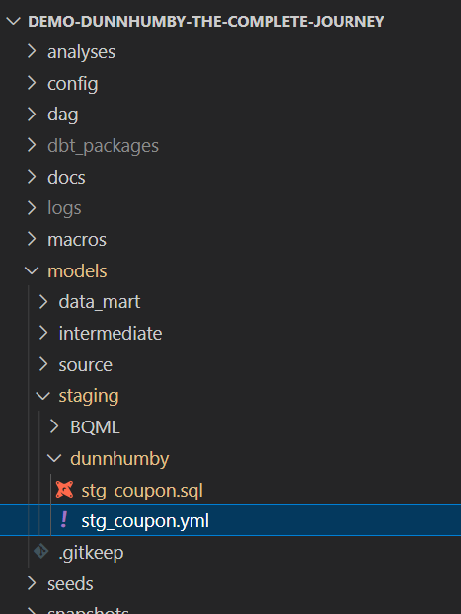
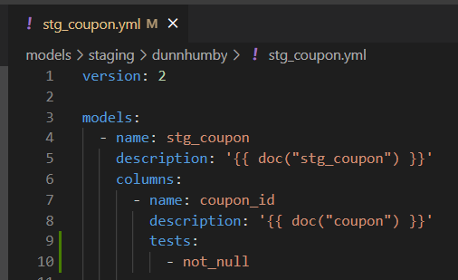
Core concepts of dbt
dbt model
Select statement
SQL file
YML file
metaconfig

Slide 16
Core concepts of dbt
Create models, calculate dependencies
{{ source( “schema”, “table” ) }}
{{ ref( “dbt_model” ) }}
model_A.sql:
select *
from {{ source( “my_schema”, “raw_table” ) }}
model_B.sql:
select *
from {{ ref( “model_A” ) }}
raw_table

Slide 17
Core concepts of dbt
Create models, calculate dependencies
{{ source( “schema”, “table” ) }} compiled
{{ ref( “dbt_model” ) }} compiled
create or replace model_A as (
select *
from “my_schema.raw_table”
)
create or replace table model_B as (
select *
from “my_schema.model_A”
)
raw_table
model_A
model_B
Lineage

Slide 18
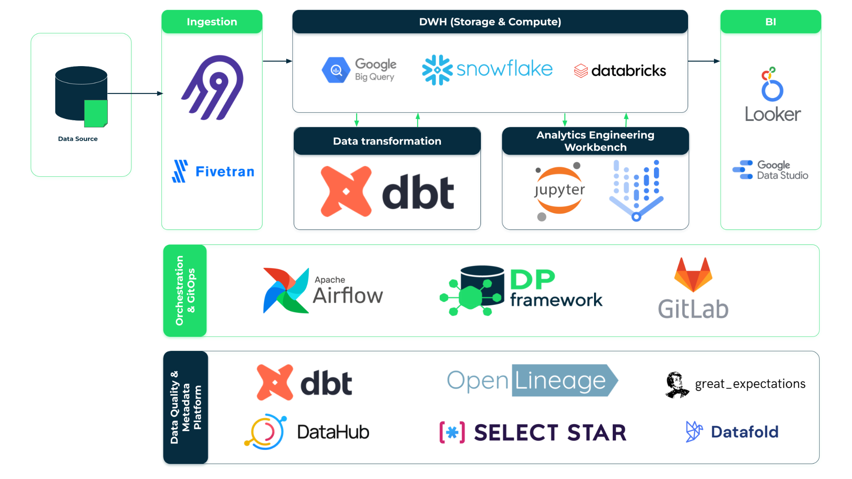
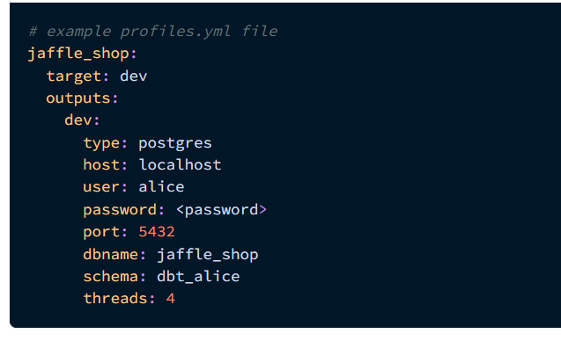
Core concepts of dbt
Connection to DWH, different environments
~/.dbt/profiles.yml
Project name
Environment
Config (dev, local, prod…)
DWH type
Address
Credentials
DB name
Default working schema
Number of threads
In Modern Data Platform:
dbt instance is installed and configured
config is stored as a part of DP framework
DWH access is granted through user’s notebook
However! User should be aware what database name or GCP project-id his dbt project will use

Slide 19
Core concepts of dbt
Hands-on:
Create your workspace
Your workbench (JupyterLab based)
GitLab project
Create and initialize dbt data transformation project
Inspect data in BigQuery
… coffee break

Slide 20
Session 2 starts at 11:00

Slide 21
Agenda
Session 2 - Simple end-to-end data pipeline
Transforming data using SQL with dbt
Data testing using dbt
Hands-on exercises

Slide 22
Transforming data with dbt
SQL = model is executed with dbt run command (CLI). While executing it, dbt will materialize an entity in your data warehouse. You can choose whether you want a view, table, ephemeral object*, incremental table or snapshot.
Execute SQL
dbt run
For better transparency and future debugging use Common Table Expressions
Write SQL
Automated tests
dbt CORE = an open source CLI tool
Text Editor / IDE
dbt test
Almost everything in dbt is a SELECT statement. As an analytics engineer / data analyst you focus on business logic. Following some internal dbt rules and good practices will cause your SQL to become a dbt model.
Test is an assertion about your model and it is also a SELECT statement. Use as much test types as you can think of. This will greatly improve a trust in data you serve to your team & stakeholders.
Validation & Deployment
docs + SQL
deployment pipeline

Slide 23
Transforming data with dbt
Sources: define your input data
dbt model
vs
dbt source
In dbt sources refer to tables that already exist in data warehouse
If data in the source table changes - it is not a result of a dbt transformation
dbt sources are defined in yaml file / files alone
Sources are referenced by using the source function
You can put tests and documentation on dbt sources
Select statement
SQL file
YML file
metaconfig
YML file
metaconfig

Slide 24
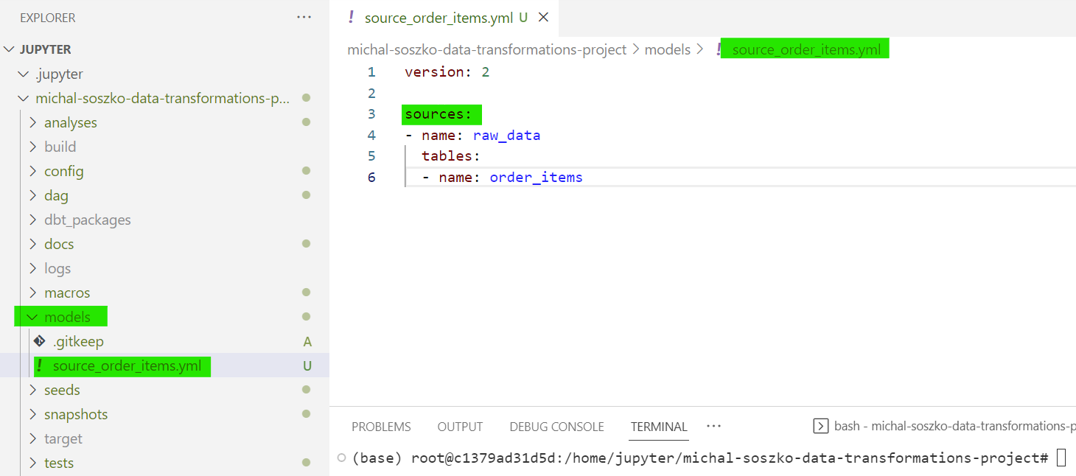
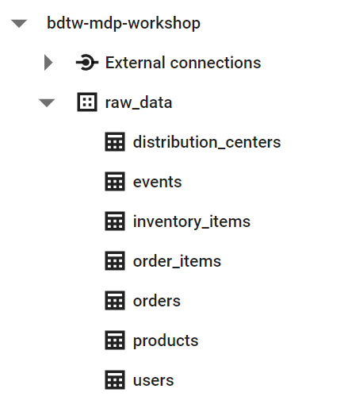
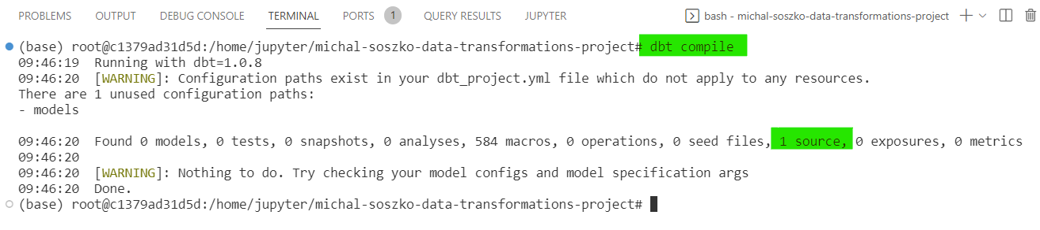
Transforming data with dbt
Sources: define your input data

Slide 25
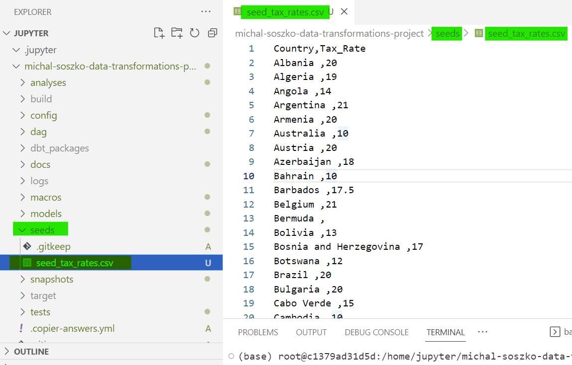
Transforming data with dbt
Seeds: add custom CSV data to your project
In dbt, seeds are small CSV files you can add to your project
Put your CSV file into seeds folder
Run command dbt seed to ingest the file as a table into the DWH
You can add meta-config yaml file to your seed
Seeds are referenced by using the ref function

Slide 26
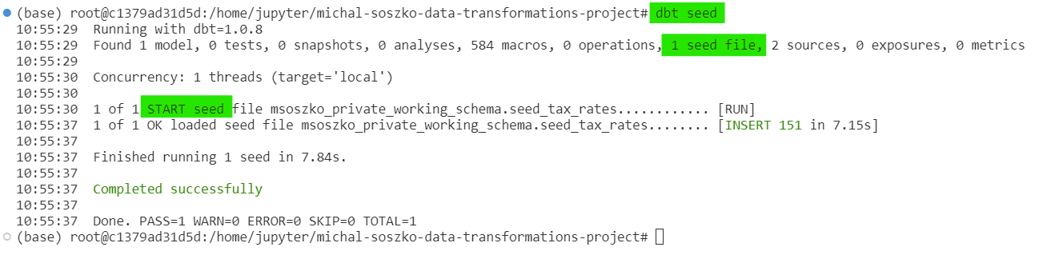
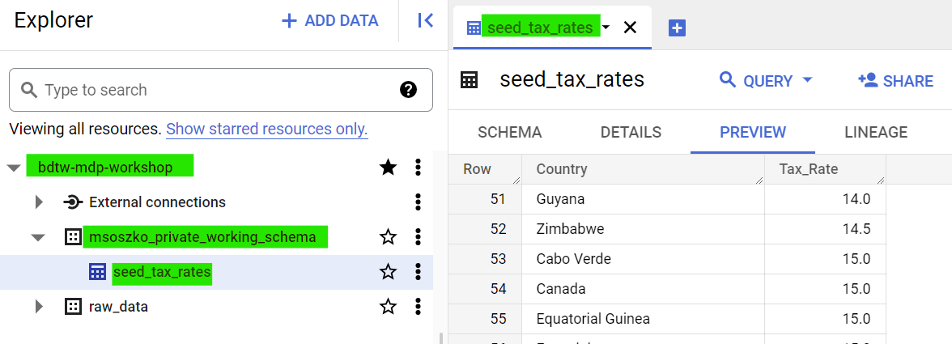
Transforming data with dbt
Seeds: add custom CSV data to your project
To run a seed type:
dbt seed
dbt seed --select seed_file

Slide 27
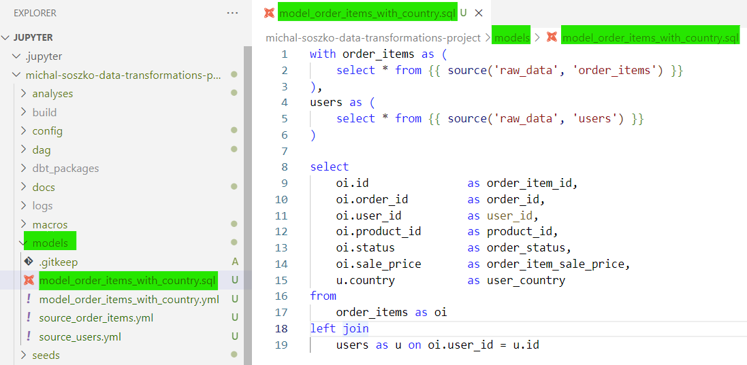
Transforming data with dbt
Models: foundation of a dbt data pipeline
Model is a select statement stored in a SQL file.
Model metaconfig yml file is optional
Executing a model with the dbt run command will create a table / view in the DWH
Models are referenced within dbt using the ref function
There are different materialization modes to choose from:
table
view
incremental table
ephemeral

Slide 28
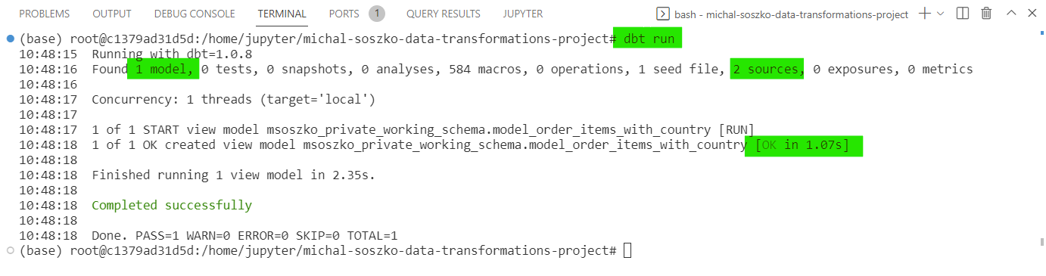
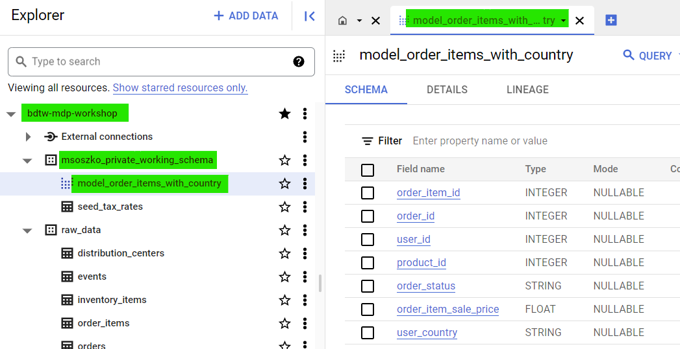
Transforming data with dbt
Models: foundation of a dbt data pipeline
To run a model type:
dbt run
dbt run --select your_model
dbt run --select +your_model+

Slide 29
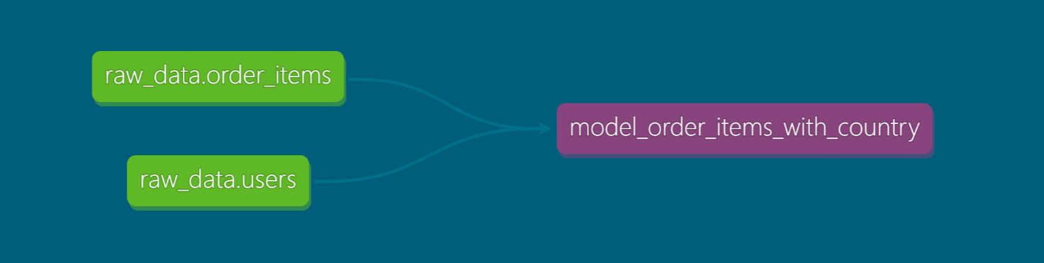
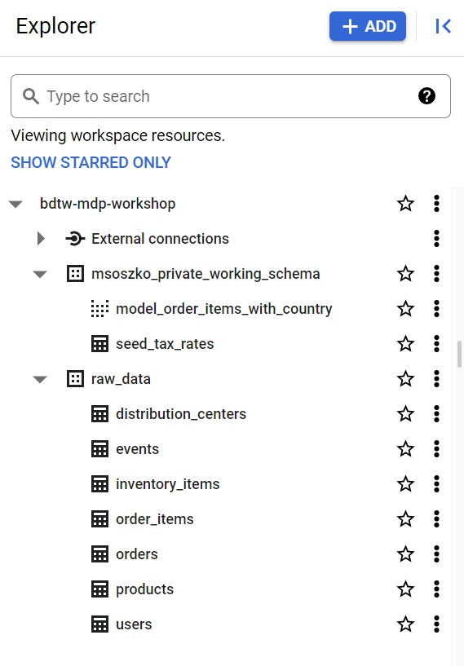
Transforming data with dbt
Models: foundation of a dbt data pipeline
dbt sources
dbt model {{ source ( ‘schema’, ‘table’ ) }}

Slide 30
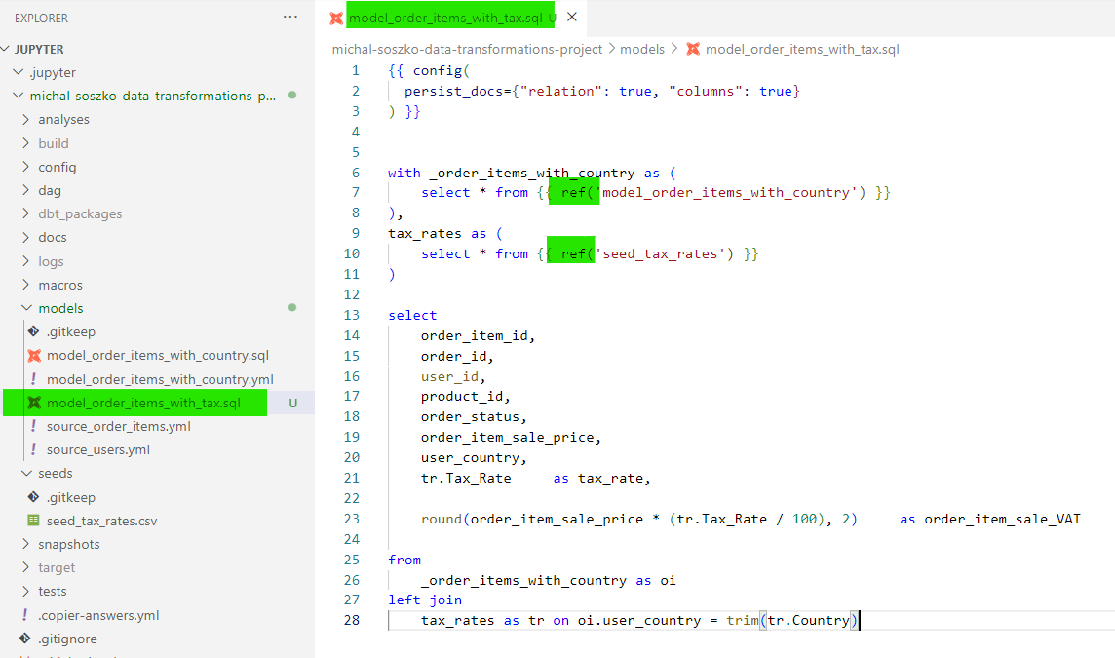
Transforming data with dbt
Models: foundation of a dbt data pipeline

Slide 31
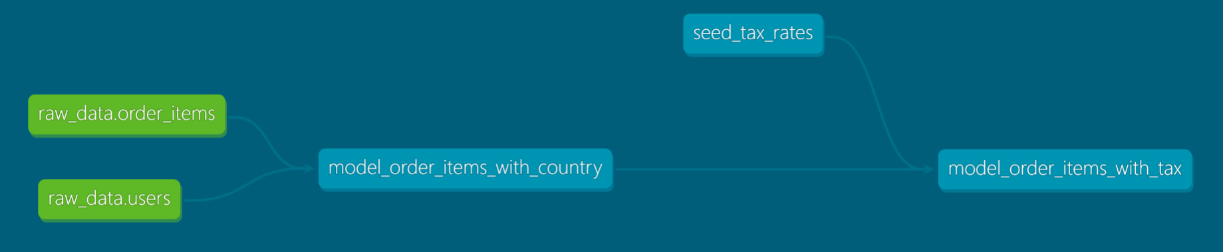
Transforming data with dbt
Models: foundation of a dbt data pipeline
dbt sources
dbt model
referencing sources {{ source ( ‘schema’, ‘table’ ) }}
dbt models
referencing other dbt entities {{ ref( ‘model_name’ ) }}
{{ ref( seed_name) }}

Slide 32
Hands-on exercises:
Open Session_2a.md and
…create your local data pipeline!

Slide 33
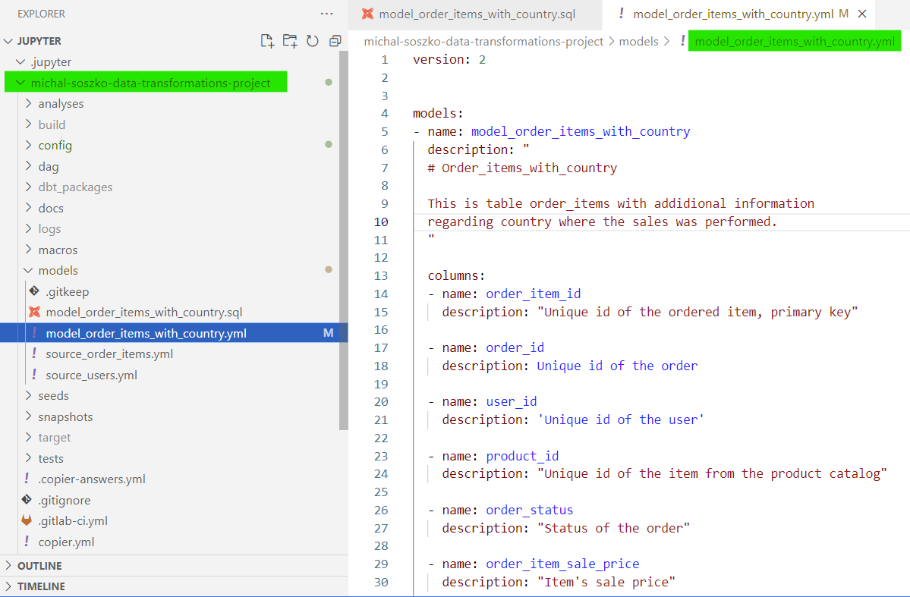
Transforming data with dbt
Models: metaconfig YAML files
Metaconfig YAML file stores descriptive information about the model.
The YAML file is optional
Allows documenting all dbt entities (models, seeds & sources) at their source
Allows adding tests to all dbt entities
Whitespace sensitive!
You can store all model, source and seed metadata in one big yaml file (however, we recommend splitting them to keep the highest granularity - ie. 1 SQL file per 1 YAML)

Slide 34
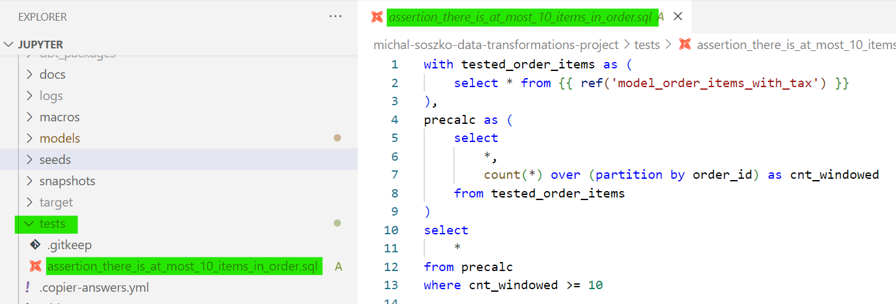
Transforming data with dbt
Data quality in dbt: tests
To run tests type:
dbt test
dbt test --select model
dbt test --select assertion
In dbt test is an assertion about your model
it is a SELECT statement
Test fails whenever at least one record is returned
Test passes whenever no data is returned
There are two types of tests: generic and singular

Slide 35
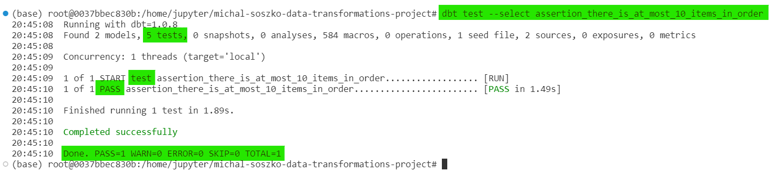
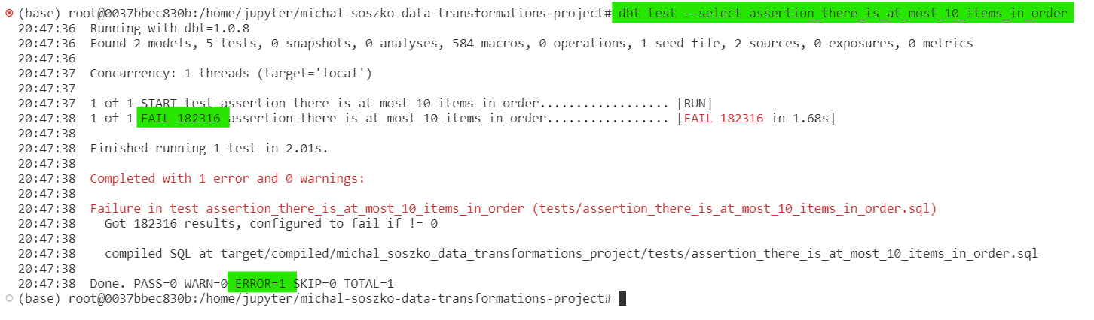
Transforming data with dbt
Data quality in dbt: tests
Success
Failure

Slide 36
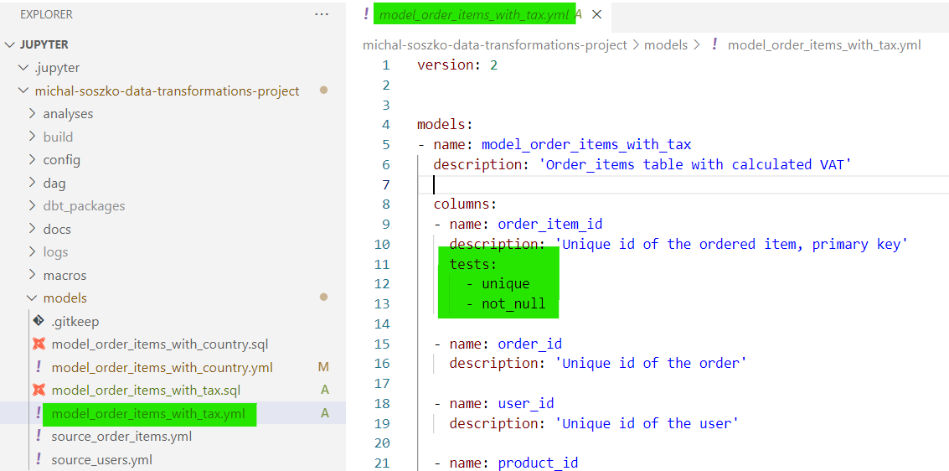
Transforming data with dbt
Data quality in dbt: tests
Generic tests can be applied to any column
There are 4 main generic tests:
not_null
unique
accepted_values
relationships
Users can define their own generic test as jinja macros
dbt community has served hundreds of custom generic tests; you can find them in many public packages:
dbt-labs / dbt_utils
calogica / dbt_expectations
and many more: https://hub.getdbt.com/

Slide 37
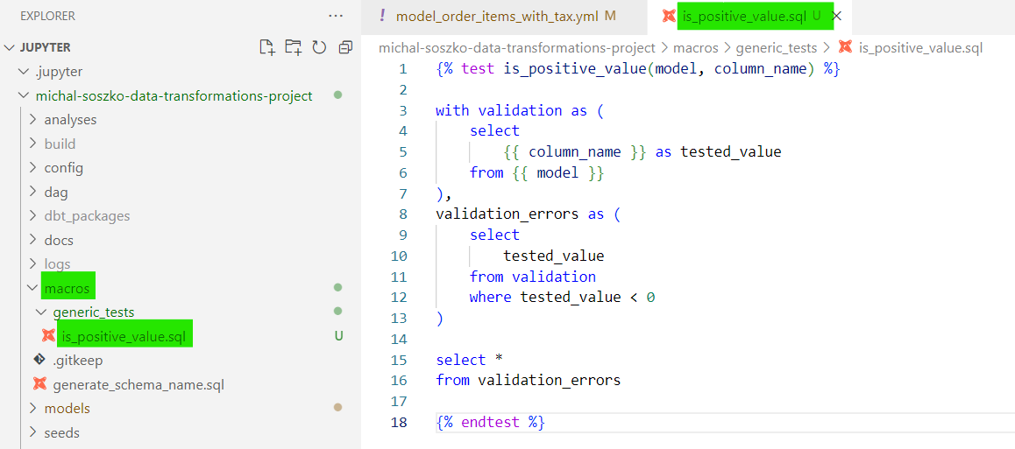
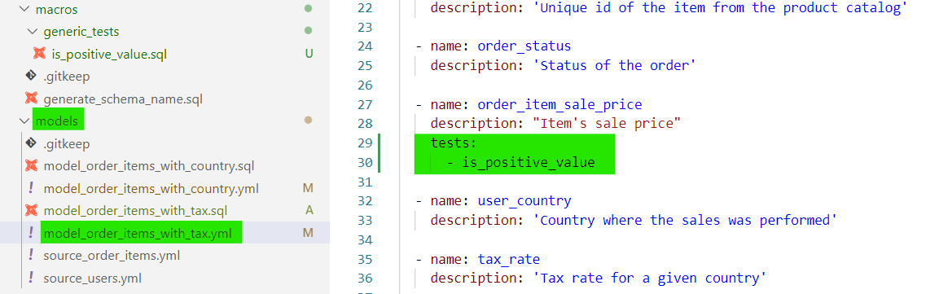
Transforming data with dbt
Data quality in dbt: tests
Generic tests can be applied to any column
There are 4 main generic tests:
not_null
unique
accepted_values
relationships
Users can define their own generic test as jinja macros
dbt community has served hundreds of custom generic tests; you can find them in many public packages:
dbt-labs / dbt_utils
calogica / dbt_expectations
and many more: https://hub.getdbt.com/

Slide 38
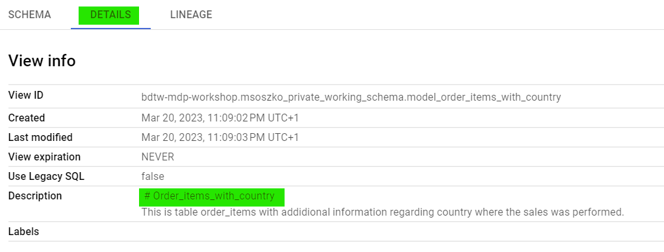
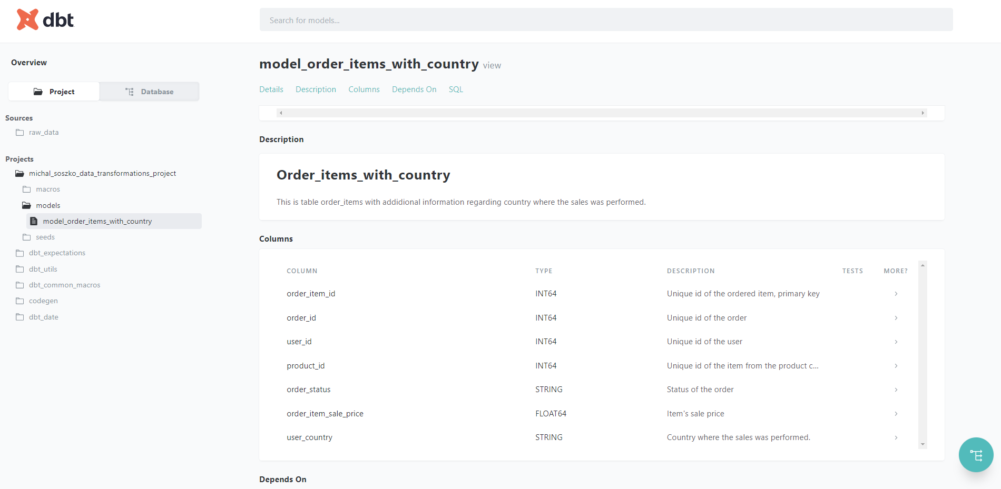
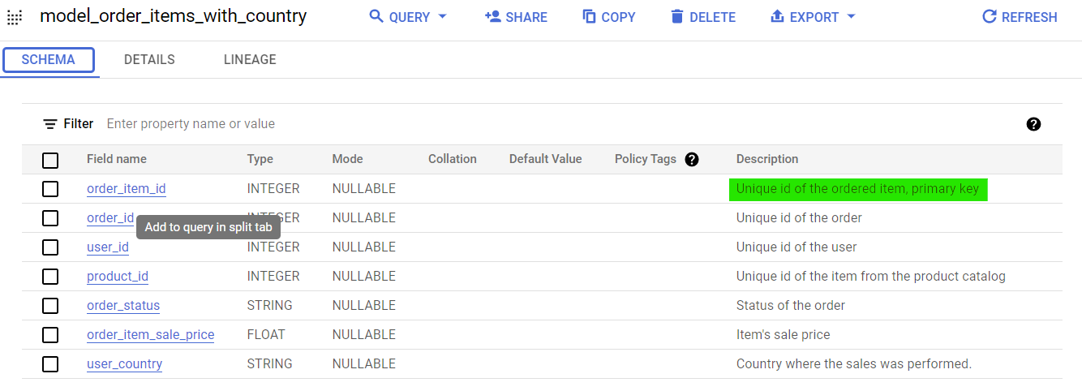
Transforming data with dbt
Documentation and graphical lineage

Slide 39
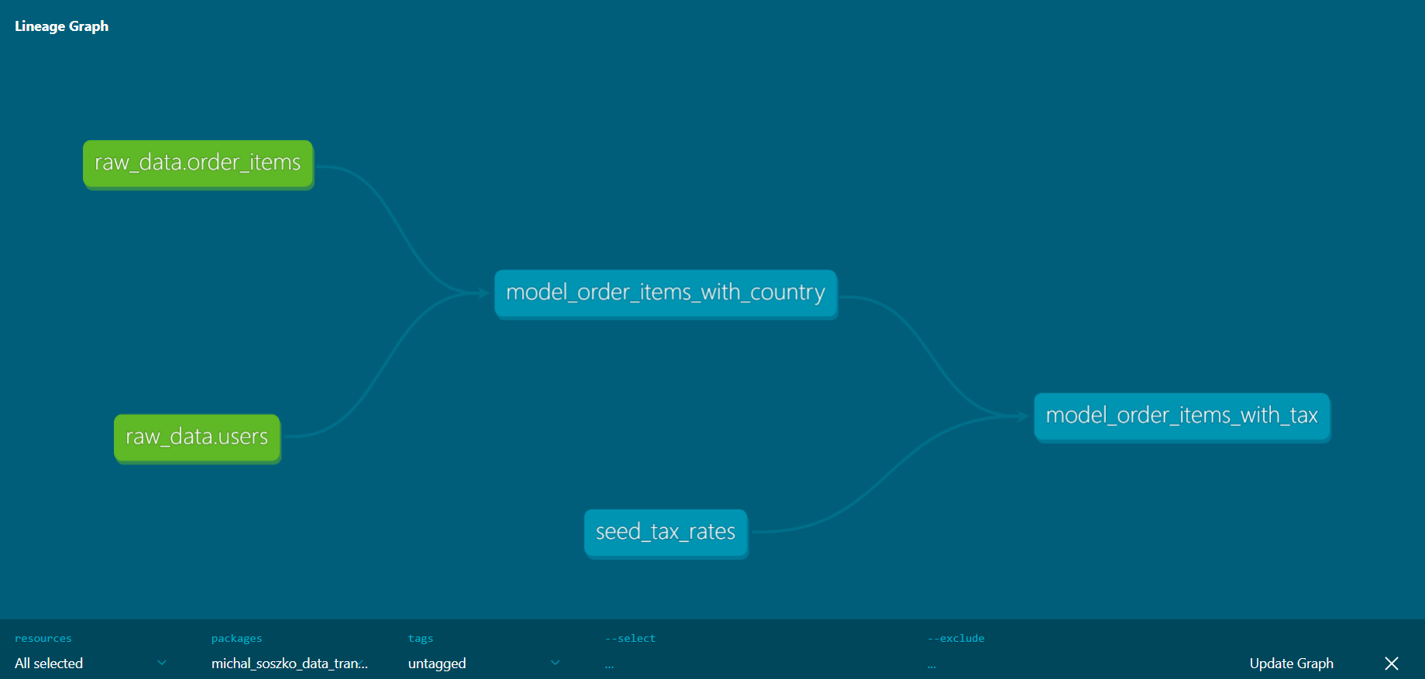
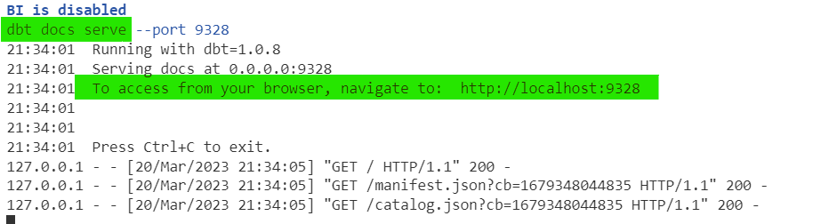
Transforming data with dbt
Documentation and graphical lineage
dbt comes with its own documentation generator
Rendered documentation can be viewed via web-browser
Model and project documentation (table / column level descriptions, project description etc.) is stored as a part of the dbt entity metaconfig YAML file.
In MDP, you can access your local documentation using the dp docs-serve command
In regular dbt-core instance accessing the local documentation requires two commands:
dbt docs generate
dbt docs serve

Slide 40
Transforming data with dbt
Documentation and graphical lineage
dbt docs generate
Modern Data Platform
DP Framework
dp docs-serve
dbt docs serve

Slide 41
Lunch Break…!
…and hands-on exercises:
Open Session_2b.md and ensure high quality of your models by adding documentation and tests to your local pipeline!

Slide 42
Session 3 starts at 13:30

Slide 43
Session 3 - Scheduling, deployment, advanced dbt concepts
Productionalization of dbt models
Data Catalog
Advanced concepts of dbt
Connecting to BI Tool: Looker Studio
Hands-on exercises

Slide 44

Transferring from local model development to DEV / PROD
User_personal_schema
stg_schema
Intermediate_schema
marts_schema
reports_schema
Local
Jupyter workspace, VSCode, dbt
Git commit & push to remote
Merge Request
Datahub
CICD
Airbyte
Airflow

Slide 45
dbt compile & the manifest file
Whenever one runs dbt run or dbt test , dbt compile runs first.
dbt compile parses SQL and YAML files, renders Jinja templates in those, and generates manifest.json file.
dbt uses manifest.json file to decide in what order it should run the models, which one should be materialized as tables and which as views, etc.
{
"metadata": {
"dbt_schema_version": "https://schemas.getdbt.com/dbt/manifest/v5.json",
"dbt_version": "1.4.0",
"generated_at": "2023-03-20T08:51:59.212464Z",
"invocation_id": "9ae5f35d-d9a0-4f71-9136-0bfc52128bea",
"env": {},
"project_id": "cf6ef8b0d94b1214ee1c83dc66bb4eb5",
"user_id": "19c06c51-fdaf-4be6-95fa-6d3724afa750",
"send_anonymous_usage_stats": true,
"adapter_type": "bigquery"
},
"nodes": {
"model.example_schema.users_basic_info": { ... },
"test.example_schema.unique_users_basic_info_id.a92193f514": { ... },
"test.example_schema.not_null_users_basic_info_id.76846ee519": { ... }
},
"sources": {
"source.example_schema.raw_ecommerce_eu.users": { ... }
},
"macros": { ... },
"docs": { ... },
"exposures": {},
"metrics": {},
"selectors": {},
"disabled": {},
"parent_map": { ... },
"child_map": { ... }
}

Slide 46
dbt compile & the manifest file
manifest.json’s node example
"model.example_schema.users_basic_info": {
"raw_sql": ...,
"compiled": true,
"resource_type": "model",
"depends_on": {
"macros": [
"macro.dbt.run_hooks",
"macro.dbt.statement",
"macro.dbt.persist_docs"
],
"nodes": [
"source.example_schema.raw_ecommerce_eu.users"
]
},
"config": {
... ,
"materialized": "table"
},
"database": "bdtw-mdp-workshop",
"schema": "example_schema",
"name": "users_basic_info",
"sources": [
[
"raw_ecommerce_eu",
"users"
]
],
"description": "This is a table with basic information about app users: first name, last name & email",
"columns": { ... },
"compiled_sql": ...,
"relation_name": "`bdtw-mdp-workshop`.`example_schema`.`users_basic_info`"
}

Slide 47
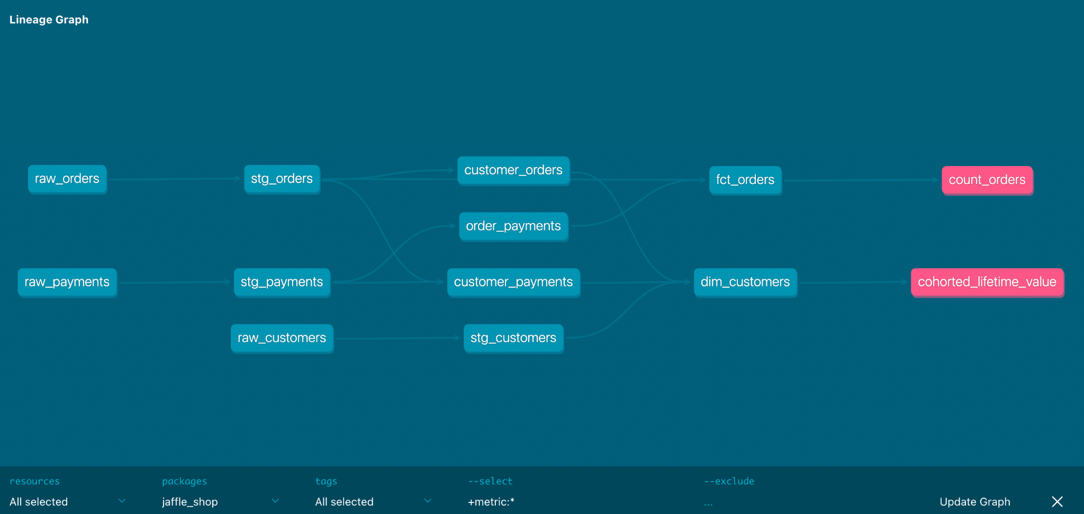
Directed Acyclic Graph
aka show me the order of operations
Source: getdbt.com

Slide 48
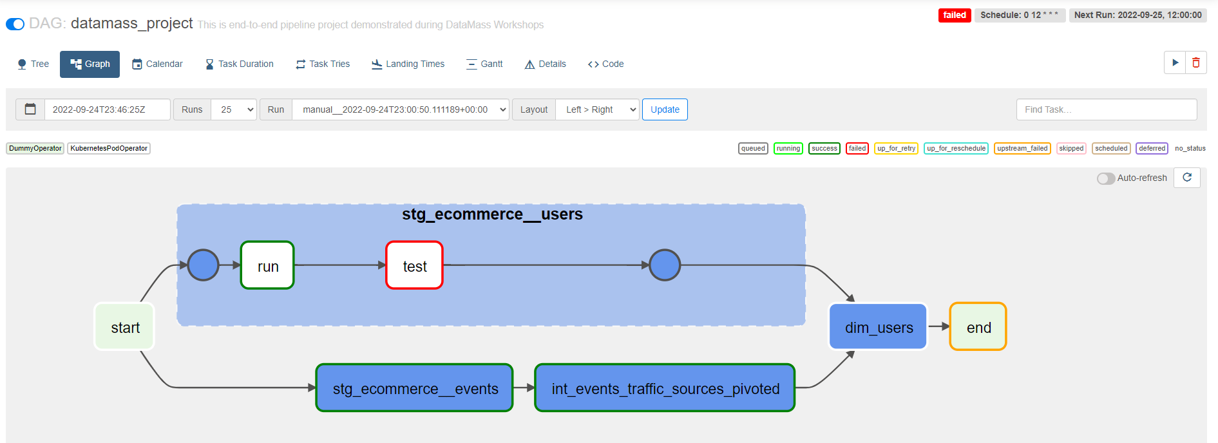
Apache Airflow as a workflow scheduler
Source: getdbt.com

Slide 49
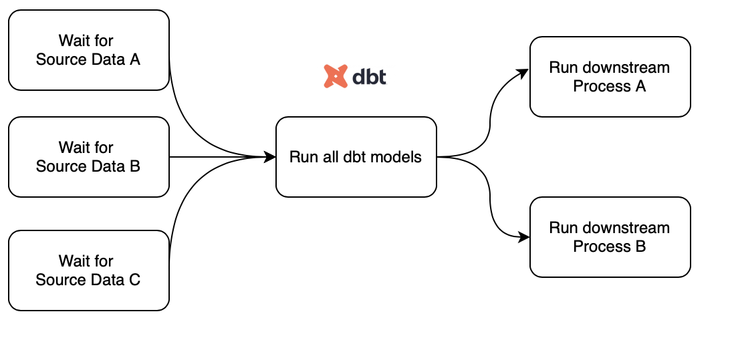
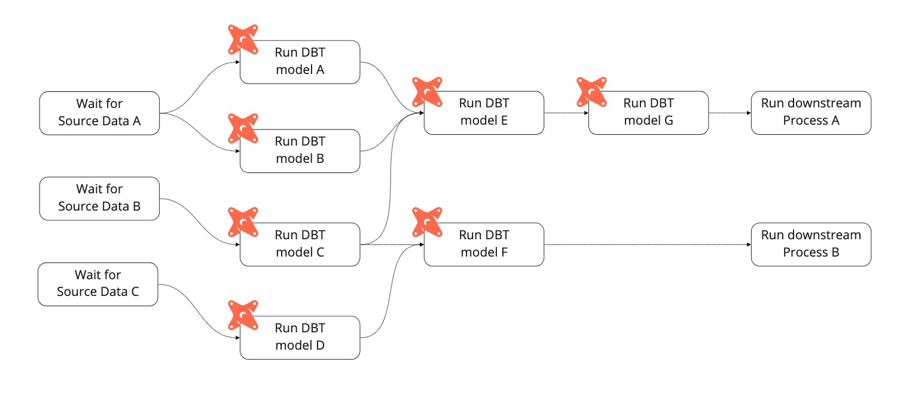
Apache Airflow as a workflow scheduler
dbt and Airflow integrations are very common
run jobs on a cron schedule
view logs
configure error notifications ( Slack)
you can orchestrate your dbt jobs to wait for data sources

Slide 50
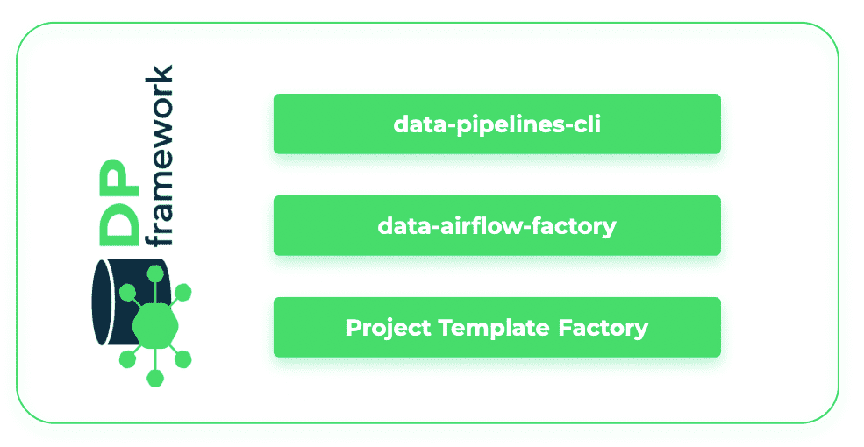
Apache Airflow as a workflow scheduler
dbt-airflow-factory is a library for parsing dbt manifest files and building Airflow DAG
The library is expected to be used inside an Airflow environment with a Kubernetes image referencing dbt
Although the tools was created by GetInData and are used in their project it is open-sourced and everyone is welcome to use and contribute to make it better and even more useful
dbt-airflow-factory

Slide 51
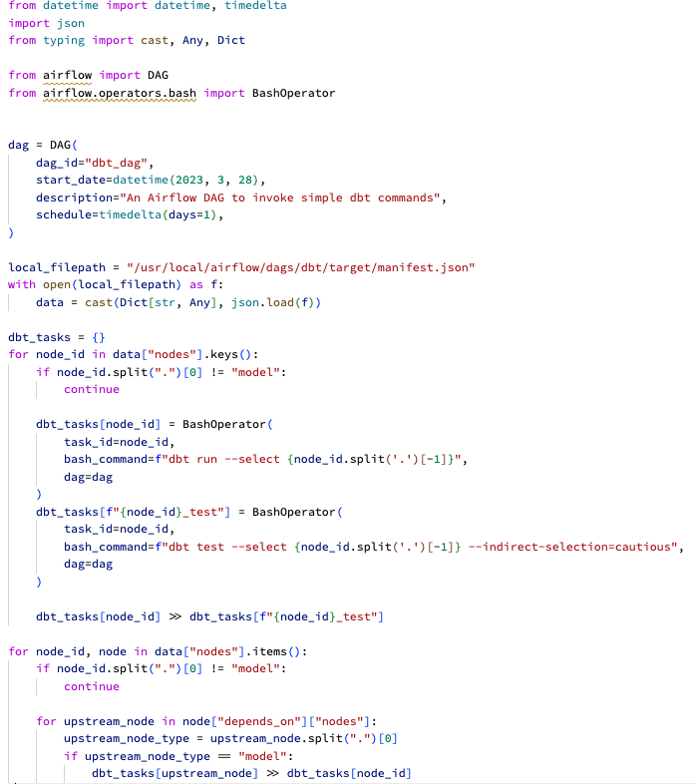
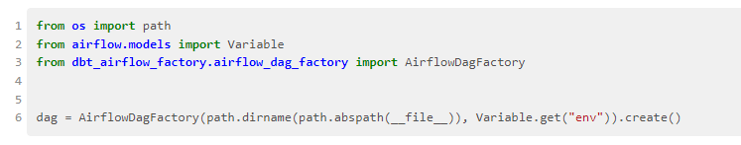
Apache Airflow as a workflow scheduler

Slide 52
CI/CD
Analytics Engineer’s perspective
git commit
git push
* MAGIC *
Dev schema’s models running in the cloud
Accept Pull (Merge) Request
* MAGIC *
Production schema’s models running in the cloud

Slide 53
CI/CD
Data Engineer’s perspective
Run dbt compile, prepare a Docker image with manifest.json and Airflow DAG
Push Docker image to Docker registry
Run DataHub ingestion
Upload DAG to a cloud bucket (GCS, S3) for Airflow (Composer) to pick it up
git commit
git push
Dev schema’s models running in the cloud
Accept Pull (Merge) Request
Production schema’s models running in the cloud

Slide 54
CI/CD
Data Engineer’s perspective
Run dbt compile, prepare a Docker image with manifest.json and Airflow DAG
Push Docker image to Docker registry
Run DataHub ingestion
Upload DAG to a cloud bucket (GCS, S3) for Airflow (Composer) to pick it up
git commit
git push
Dev schema’s models running in the cloud
Accept Pull (Merge) Request
Production schema’s models running in the cloud
dp compile
dp deploy

Slide 55
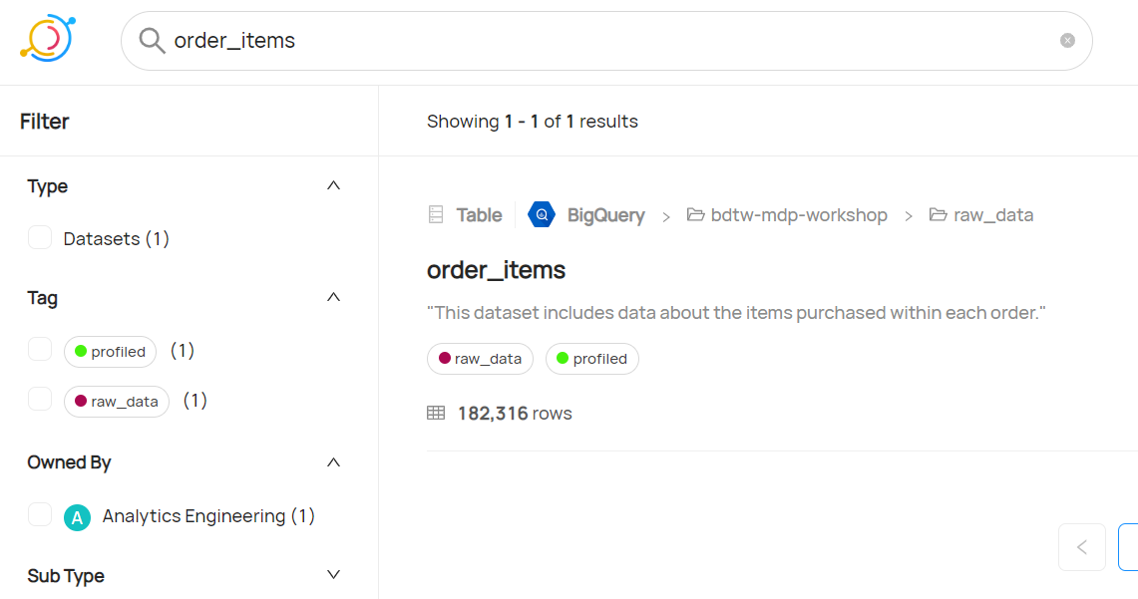
Data Catalog - about
Single source of knowledge about your data
“Google” for your data assets
Where’s my data?
What’s it’s provenance and usage?
Who’s the data owner?
What’s the quality of my data?
Metadata platform that enables data discovery, data observability and federated governance
Metadata is automatically refreshed by data pipelines and CI/CD processes

Slide 56
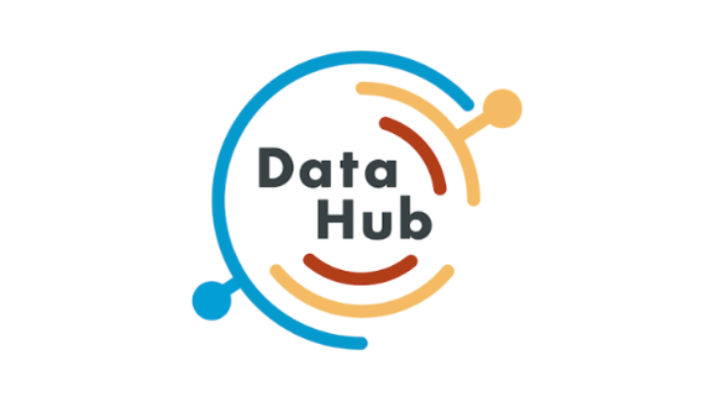
Data Catalog - features
Single source of knowledge about your data
Data search
Query history
Usage statistics
Data definition
Data documentation
Data lineage
Data profiling
Data quality
Business glossary
Data classification
Data ownership
Access control

Slide 57
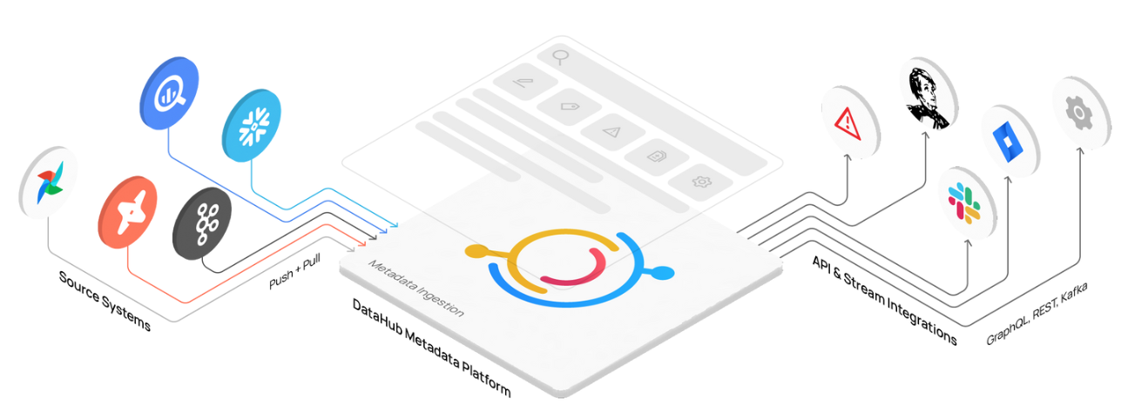
Data Catalog
Single source of knowledge about your data
DataHub: demo

Slide 58
Data Catalog
Single source of knowledge about your data
DataHub access:
User name & Password: ->
check on Teams channel

Slide 59
Advanced concepts of dbt
Core dbt configuration
profiles.yml
configuring your environments (local, DEV, PROD etc)
dbt_project.yml
Specify operations/metaconfig. Every dbt project has one
specific dbt object .yml files
Each dbt object can have its config done in separate file or it all can be grouped in schema.yml files in respective directories
Covered by MDP
Flexible set-up by MDP
User-defined objects

Slide 60
Advanced concepts of dbt
Model materialization
Table
Model deployed as table in DWH, recalculating on every dbt run
View
Model deployed as view in DWH, recreating on every dbt run
Ephemeral
Model deployed is NOT deployed in DWH but it’s transferred to downstream SELECT statements in form of CTE
Incremental
Model deployed as table, appending new records if detected per every dbt run
Snapshot
deployed as table, appending new records when there has been a change in existing data, executed in separate run

Slide 61
Advanced concepts of dbt
Model materialization: incremental
A Table
First dbt run: all rows from source data
Subsequent run: transform & insert / update only for filtered source data
Makes use of is_incremental() macro and {{this}} variable
On incremental run dbt executes a script consisting of multiple DDL and SQL statements involving:
Temp tables
Clustering
Partitioning …
Different incremental strategies: merge , append , inser_overwrite , delete+insert for different databases (BQ, Snowflake, Postgress…)
Reduces the amount of data to be transformed per run
Improves runtime, performance
Reduces compute cost
Introduces complexity

Slide 62
Advanced concepts of dbt
Model materialization: snapshot
A “look back in time” in the mutable table
DBT implementation of type-2 slowly changing dimensions (SCD-2)
A table storing history of records with additional meta-information:
dbt_valid_from: timestamp of the snapshot row was inserted
dbt_valid_to: timestamp when this row became invalidated (the most recent records will have this value nullified)
dbt_scd_id: unique key for each snapshotted records
dbt_updated_at: timestamp for the snapshot records row was inserted
Different trigger command: dbt snapshot -> this executes DDL + SQL script
Strategy:
Timestamp: dbt inspects the timestamp and inserts new record if it has changed, ie. updated_at
Check: dbt takes list of columns and compares between their current (current run) and historical (most recent run) values

Slide 63
Advanced concepts of dbt
Structuring the project
Raw
Staging
Intermediate
Data Mart
dbt sources
no transformations allowed
tests allowed
dbt does not materialize sources
sources =/= models
“Engineering” layer
sublayers: data sources
base and staging models
Initial cleaning & transformations
applying column naming conventions
concatenating
splitting
filtering
applying simple formulas
formatting
JOINs- not recommended
aggregations - strongly not recommended
tests recommended
docs recommended
“Transition” layer
sublayers: business teams
advanced transformations
pivoting
aggregations
JOINs
applying advanced business logic
advanced formulas and functions
tests recommended
docs recommended
“Business” layer
sublayers: business teams
final JOINs
final aggregations
final filtering
quality checked (tests are obligatory)
documentation is obligatory (detailed description for columns, tables, tests, exposures etc)
Snapshots
SCD-2
can serve as a pre-staging layer
JOINs - strongly not recommended
aggregations - strongly not recommended

Slide 64
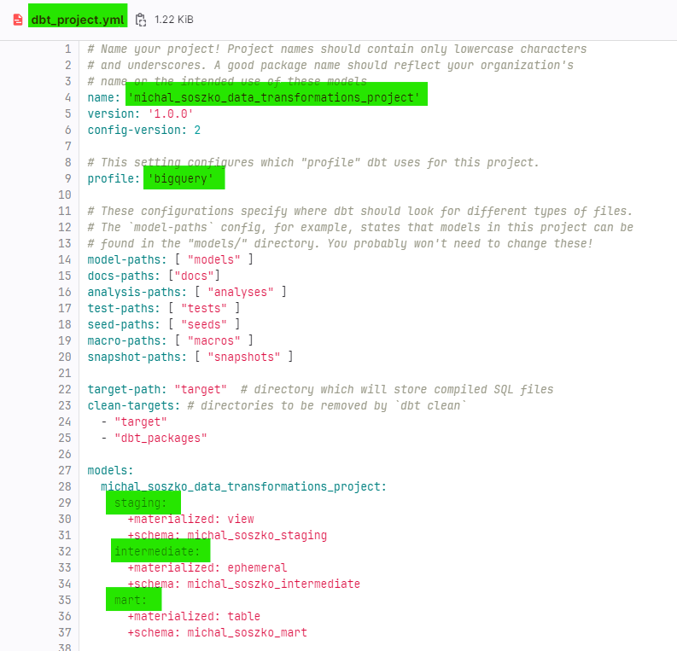
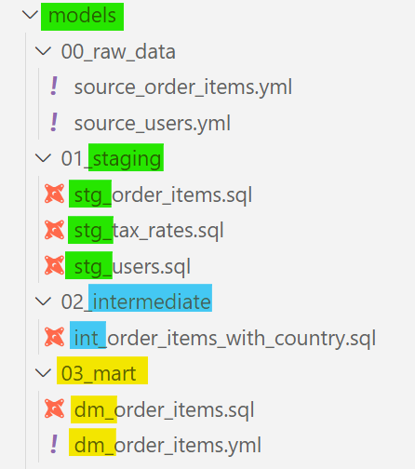
Advanced concepts of dbt
Structuring the project
Raw
Snapshots
Staging
Intermediate
Data Mart

Slide 65
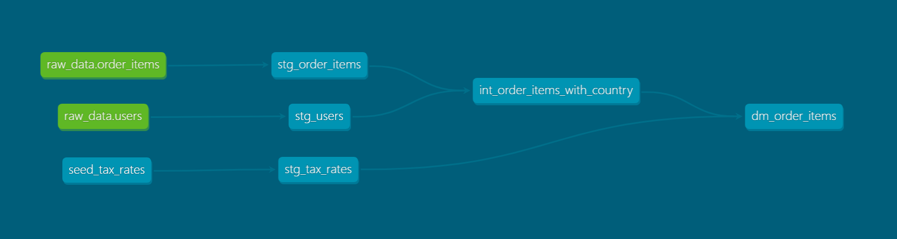
Advanced concepts of dbt
Structuring the project
Raw
Staging
Intermediate
Data Mart
dbt sources
no transformations allowed
tests allowed
dbt does not materialize sources
sources =/= models
“Engineering” layer
sublayers: data sources
base and staging models
Initial cleaning & transformations
applying column naming conventions
concatenating
splitting
filtering
applying simple formulas
formatting
JOINs- not recommended
aggregations - strongly not recommended
tests recommended
docs recommended
“Transition” layer
sublayers: business teams
advanced transformations
pivoting
aggregations
JOINs
applying advanced business logic
advanced formulas and functions
tests recommended
docs recommended
“Business” layer
sublayers: business teams
final JOINs
final aggregations
final filtering
quality checked (tests are obligatory)
documentation is obligatory (detailed description for columns, tables, tests, exposures etc)
Snapshots
SCD-2
can serve as a pre-staging layer
JOINs - strongly not recommended
aggregations - strongly not recommended

Slide 66
Advanced concepts of dbt
Naming convention
staging_<dataset>__ <table>
stg_<dataset>__<table>
stg_<table>
base_<dataset>__ <table>
base_<table>
Staging
source_<dataset>__ <table>
src_<dataset>__<table>
src_<table>
Raw
Intermediate
int_<descriptive_name>
example: int_active_users_with_mapped_payments_agg_daily
Snapshots
snapshot_<dataset>__<table>
snapshot_<table>
dm_<name>
mart_<name>
dm_<business_unit>__<name>
mart_<business_unit>__<name>
<name>
<business_unit>_<name>
dm_<short_descriptive_name>
mart_<short_descriptive_name>
examples:
dm_users, mart_active_subscriptions_aggd,
mart_marketing__campaigns
Data Mart

Slide 67

DEMO:
Simple dbt pipeline scheduled with Airflow
Connection to BI Tools

Slide 68
hands-on exercises:
Open Session_3.md and start reforging your dbt pipeline into well structured project and then use GitLab to publish your work on prod.

Slide 69
Session 4 starts at 16:00

Slide 70

Q&A

Slide 71
Let’s summarize
Concept of MDP
Core concepts of dbt
Created dbt project using MDP environment
Created simple data transformation pipeline locally
Applied data quality checks & docs
Refined project structure
Published data pipeline to “prod”
Scheduled run & prepared tables for analysis

Slide 72

Wrap up
Thank you!
Contact us!
https://getindata.com/estimate
Our blog
https://getindata.com/blog
Our podcast
Radio DaTa

